Slide 1
Lab 10 Correlated Subquery and Division
United International College
COMP3013 DBMS

Slide 2
Outline
Division
Correlated subquery

Slide 3
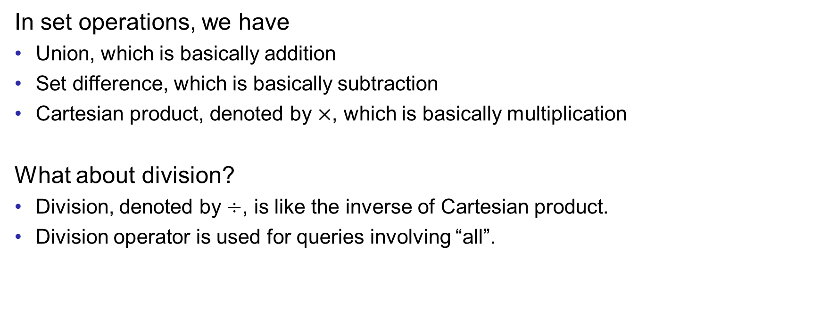
Division in Set Operations
In set operations, we have
Union, which is basically addition
Set difference, which is basically subtraction
Cartesian product, denoted by $×$, which is basically multiplication
What about division?
Division, denoted by $÷$, is like the inverse of Cartesian product.
Division operator is used for queries involving “all”.

Slide 4

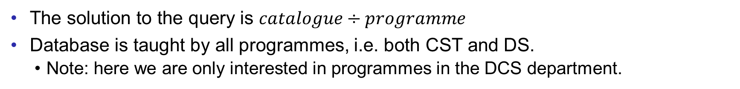


Division Example
Query: “Retrieve (all) course names that is/are taught by all programmes.”
The first “all” in parenthesis doesn’t count; every query requires that “all”
The second “all” suggests division should be used.
$$catalogue$$
$$programme$$
$$catalogue÷programme$$
c_name | p_name
Database | CST
OS | CST
Database | DS
Data Analytics | DS
p_name
CST
DS
c_name
Database
The solution to the query is $catalogue÷programme$
Database is taught by all programmes, i.e. both CST and DS.
Note: here we are only interested in programmes in the DCS department.

Slide 5
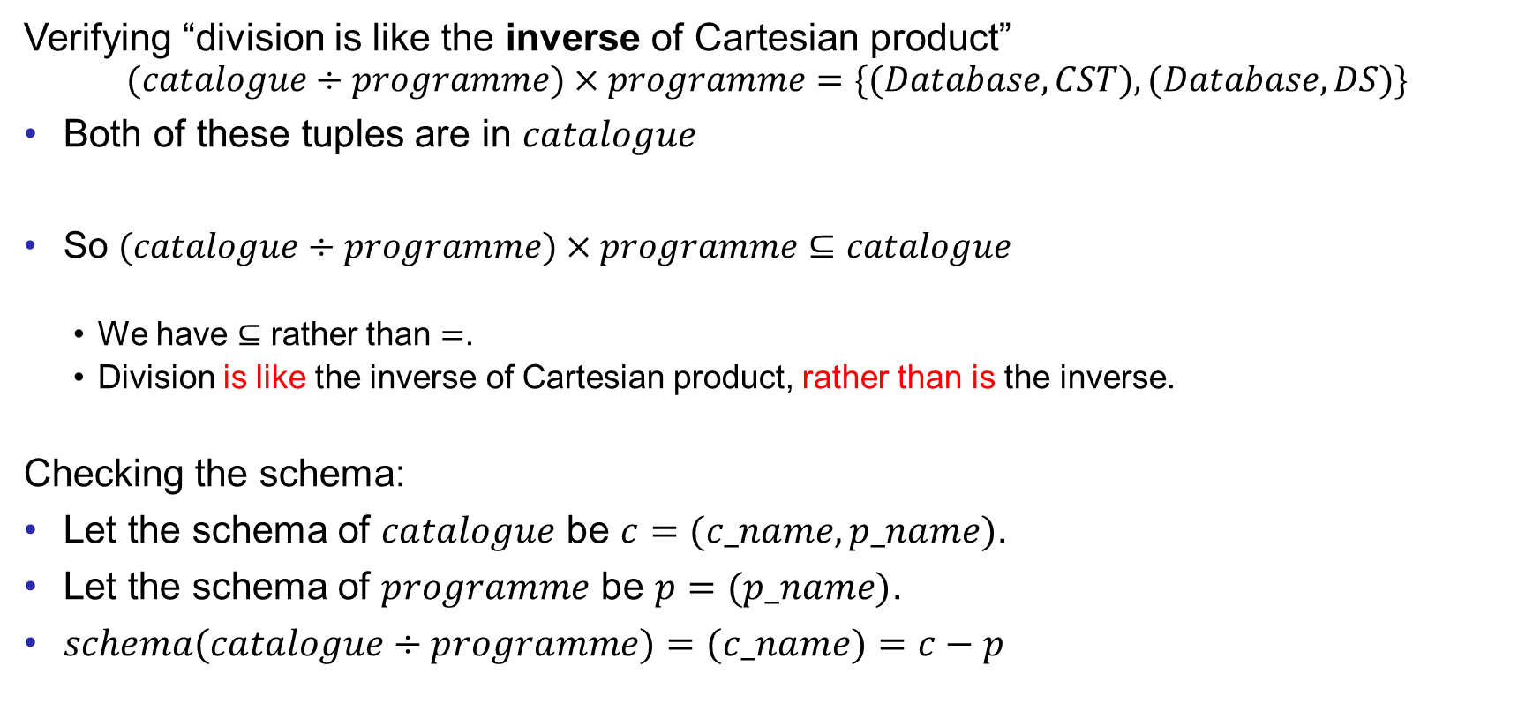
Division Example
Verifying “division is like the inverse of Cartesian product”
$$(catalogue÷programme)×programme=\{(Database, CST), (Database, DS)\}$$
Both of these tuples are in $catalogue$
So $(catalogue÷programme)×programme⊆catalogue$
We have $⊆$ rather than $=$.
Division is like the inverse of Cartesian product, rather than is the inverse.
Checking the schema:
Let the schema of $catalogue$ be $c=(c_name, p_name)$.
Let the schema of $programme$ be $p=(p_name)$.
$schema(catalogue÷programme)=(c_name)=c−p$

Slide 6
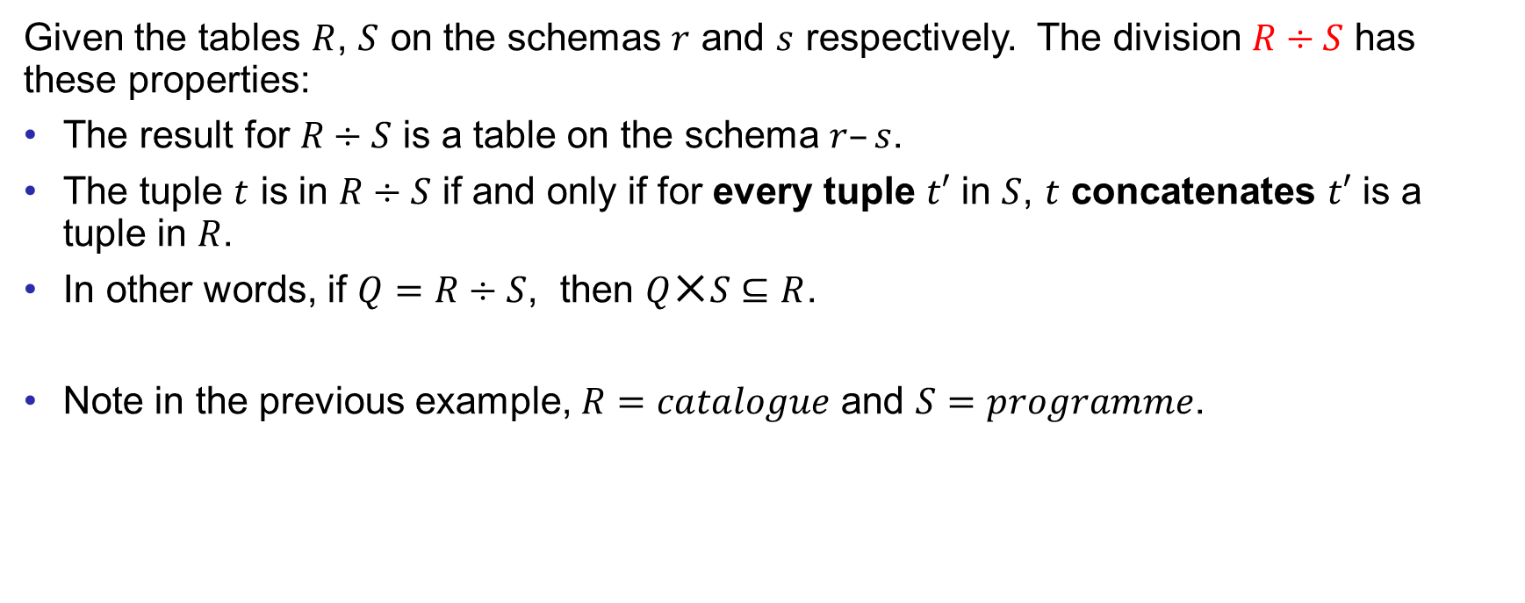
Division Definition and General Properties
Given the tables $R$, $S$ on the schemas $r$ and $s$ respectively. The division $R÷S$ has these properties:
The result for $R÷S$ is a table on the schema $r–s$.
The tuple $t$ is in $R÷S$ if and only if for every tuple $t′$ in $S$, $t$ concatenates $t′$ is a tuple in $R$.
In other words, if $Q=R÷S$, then $Q✕S⊆R$.
Note in the previous example, $R=catalogue$ and $S=programme$.
Notes:
Chap 2 PPT has examples in Slide 42 and 43.

Slide 7
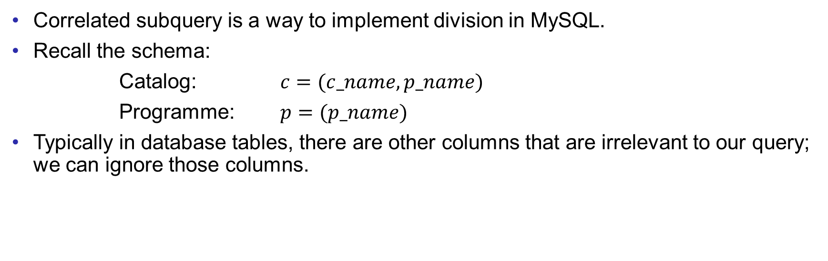
Correlated Subquery
Correlated subquery is a way to implement division in MySQL.
Recall the schema:
Catalog: $c=(c_name,p_name)$
Programme: $p=(p_name)$
Typically in database tables, there are other columns that are irrelevant to our query; we can ignore those columns.

Slide 8
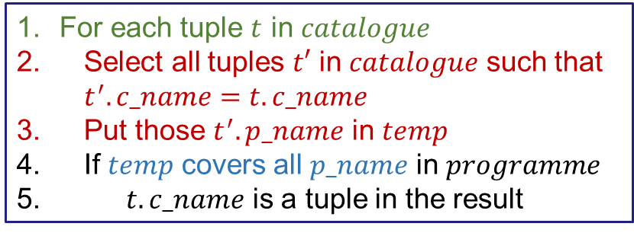



Correlated Subquery
For the query, “Retrieve (all) course name that is/are taught by all programmes”, the solution is $catalogue÷programme$.
Suppose we are allowed to use a programming language for this task. Then,
We just need to implement it in SQL.
For each tuple $t$ in $catalogue$
Select all tuples $t′$ in $catalogue$ such that $t^{′}.c_name=t.c_name$
Put those $t^{′}.p_name$ in $temp$
If $temp$ covers all $p_name$ in $programme$
$t.c_name$ is a tuple in the result
for each tuple $t$ in $catalogue$
$temp←\{\}$
for each tuple $t′$ in $catalogue$
if $t.c_name=t^{′}.c_name$
$temp←temp∪\{t^{′}.p_name\}$
end if
end for
if $programme−temp=∅$ then
$t$ is in the result
end if
end for
$temp$ covers all $p_name$ is equivalent to $programme⊆temp$,
which is further equivalent $programme −temp=∅$.
Then, the code can be…

Slide 9




Correlated Subquery Implementation of Division
for each tuple $t$ in $catalogue$
$temp←\{\}$
for each tuple $t′$ in $catalogue$
if $t.c_name=t^{′}.c_name$
$temp←temp∪\{t^{′}.p_name\}$
end if
end for
if $programme−temp=∅$ then
$t$ is in the result
end if
end for
Everything from Line 3 to 10 (in NOT EXISTS) is a logical test.
It is done on every tuple in $C1$ on Line 2 .
To test $programme−temp=∅$, NOT EXISTS is used. It returns TRUE if it is followed by an empty set (in the blue parenthesis (…)).
To calculate $programme−temp$, EXCEPT is used for set minus.
SELECT $C1.c_name$
FROM $catalogue$ AS $C1$
WHERE NOT EXISTS (
(SELECT $p_name$
FROM $programme$)
EXCEPT
(SELECT $p_name$
FROM $catalugue$ AS $C2$
WHERE $C2.c_name=C1.c_name$)
)
Dividend
$$catalogue$$
$$÷$$
$$programme$$
Divisor

Slide 10
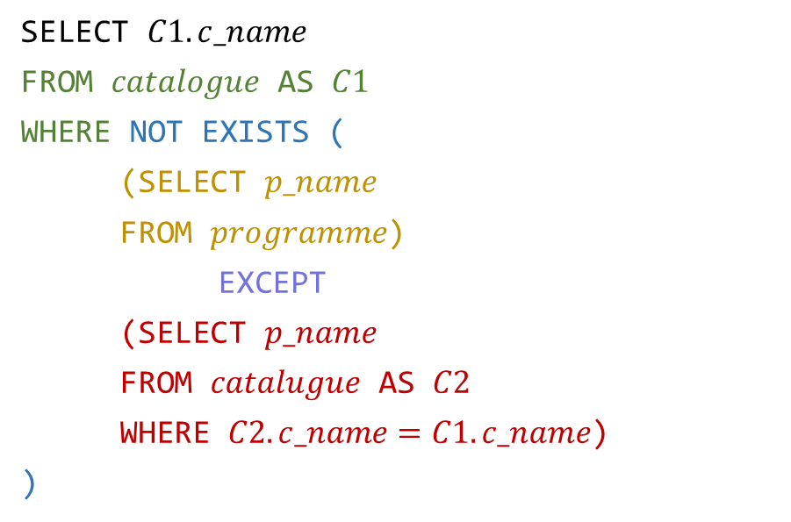
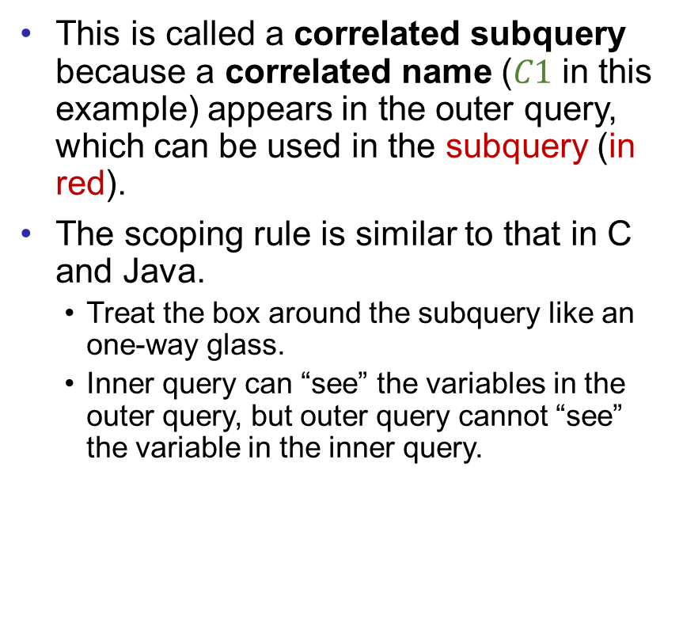
Correlated Subquery Implementation of Division
This is called a correlated subquery because a correlated name ($C1$ in this example) appears in the outer query, which can be used in the subquery (in red).
The scoping rule is similar to that in C and Java.
Treat the box around the subquery like an one-way glass.
Inner query can “see” the variables in the outer query, but outer query cannot “see” the variable in the inner query.
SELECT $C1.c_name$
FROM $catalogue$ AS $C1$
WHERE NOT EXISTS (
(SELECT $p_name$
FROM $programme$)
EXCEPT
(SELECT $p_name$
FROM $catalugue$ AS $C2$
WHERE $C2.c_name=C1.c_name$)
)
Correlation

Slide 11

Correlated Subquery Implementation of Division
The subquery in the WHERE clause will be executed for every tuple from the main query. Thus, correlated subquery is NOT efficient.
(NOT) EXISTS can do many other tasks besides division. Don’t be limited.
A set minus can also be implemented by NOT IN.
SELECT * because NOT EXISTS only checks whether the set is empty. The tuples in the set are not important.
SELECT $C1.c_name$
FROM $catalogue$ AS $C1$
WHERE NOT EXISTS (
SELECT *
FROM $programme$
WHERE $p_name$ NOT IN(
SELECT $C2.p_name$
FROM $catalogue$ AS $C2$
WHERE $C2.c_name=C1.c_name$
)
)

Slide 12
Example
In the “sakila” database, find the id of the customers who have rented some films from all staffs.

Slide 13
Exercises
Using the UIC database, write a MySQL query to find the following.
Which customer(s) has rented some films from all stores?
Which customer(s) has rented at least one film in every category?
Which customer(s) has rented at least one film in each rating? Assume that every rating has at least one film.
(Hint: use SELECT DISTINCT to remove redundant rating)
Save your queries in a txt file. Rename it as “COMP3013 Lab10 ###.txt”, where “###” is your student ID. And submit it on iSpace. The DDL is 24 hours after the lab.

Slide 14
End of Lab 10

